Slide 1
Practical Exam Presentation
Pens and Printers sales analysis

Slide 2
Business Goals
Six weeks ago we launched a new line of office stationery. Despite the world becoming
increasingly digital, there is still demand for notebooks, pens and sticky notes.
We have tested three different sales strategies - Email, Call and Email + Call sales method.
Based on the current data, which method would we recommend your team continue to use?

Slide 3
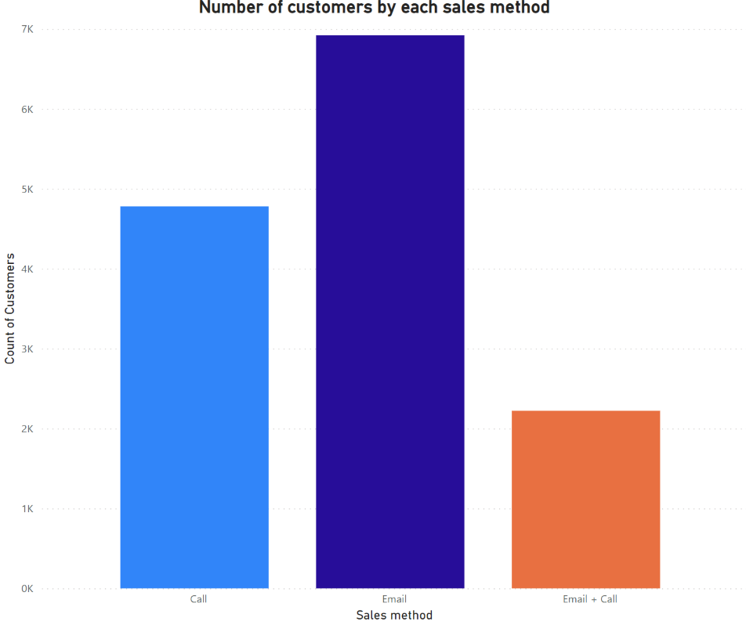
Outcomes How many customers were there for each approach?
Around half of total customers were purchased by Email method which had biggest customer group comparing with the other two methods.
the Email+Call approach helped less than 2300 customers to buy the products, which was only 1/3 of customers purchased by Email method.
the Call method triggered about 5000 customers for purchasing the new products which was ranked as the second sales method.

Slide 4
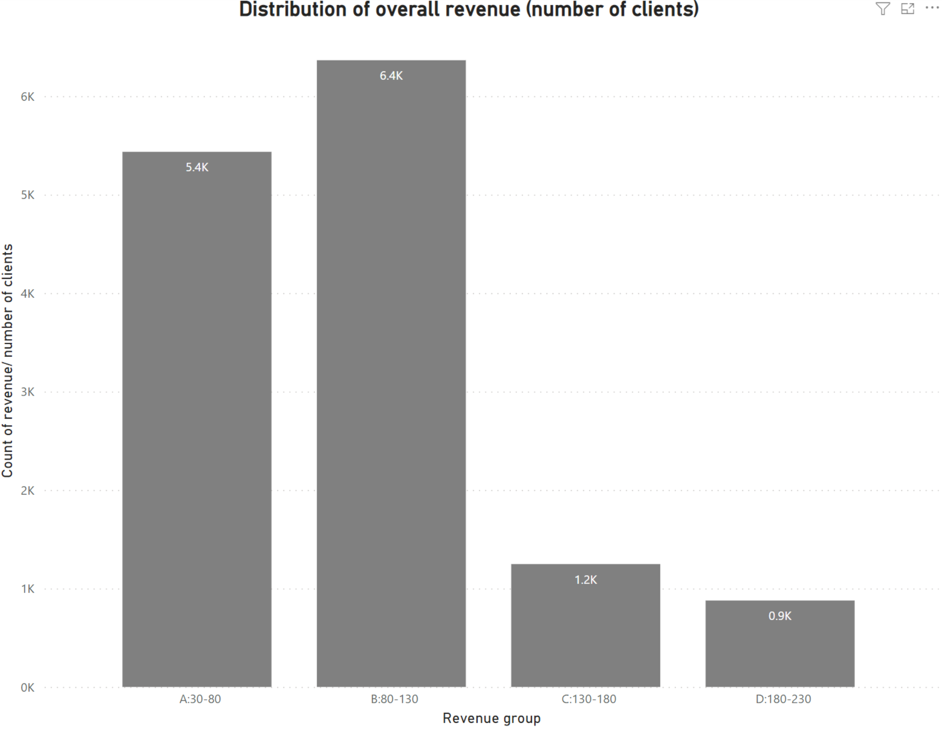
Outcomes What does the spread of the revenue look like overall?(A)
We categorised as four revenue group(A-D) base on the revenue records from low, medium to high.
The largest number of customers (6400) who generated revenue about from 80 to 130 (B: medium revenue group).
There were 5400 customers who bought products worth from 30 to 80 (A: low revenue group).
The other two high revenue groups- C (130-180) and D (180-230) represented around 1000 clients respectively which was only 1/5 of B (80-30) group.

Slide 5
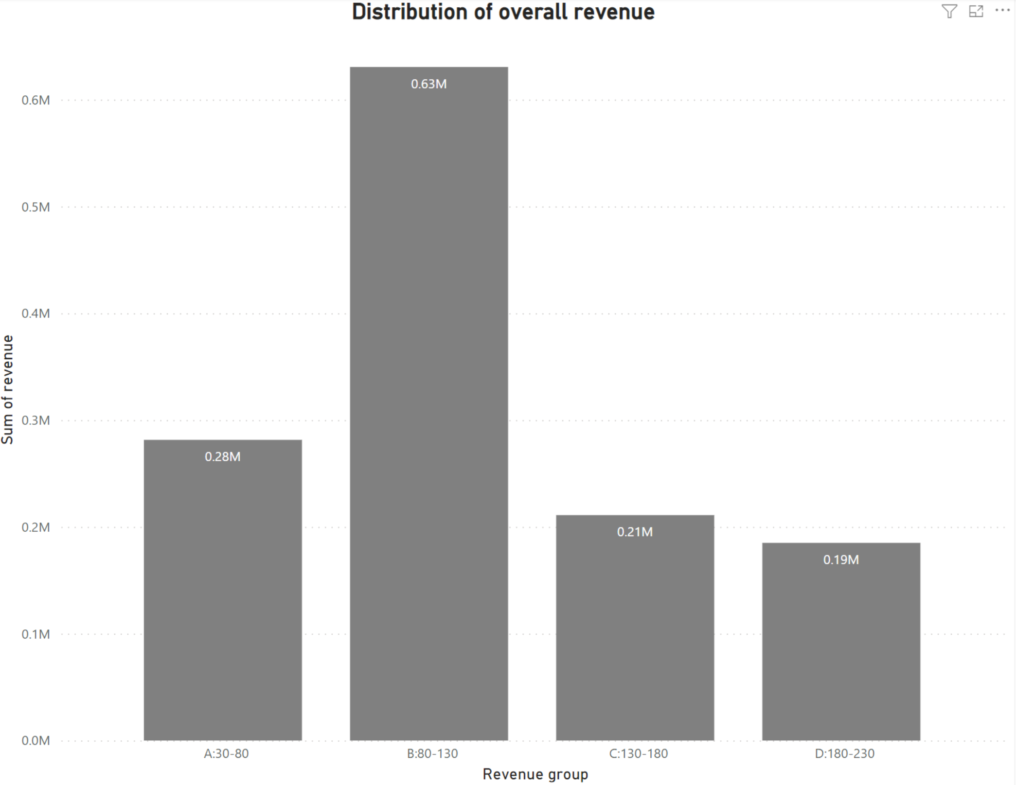
Outcomes What does the spread of the revenue look like overall?(B)
The B (80-130) group took the first place and generated 0.63 million revenue which is more than three times higher than other three groups.
Revenue of the all other three groups- A(30-80), C(130-180) and D(180-230) were around 0.2-0.3 million.
Despite the A groups contained fairly high number of customers in the previous section, but the revenue group was quite low.

Slide 6
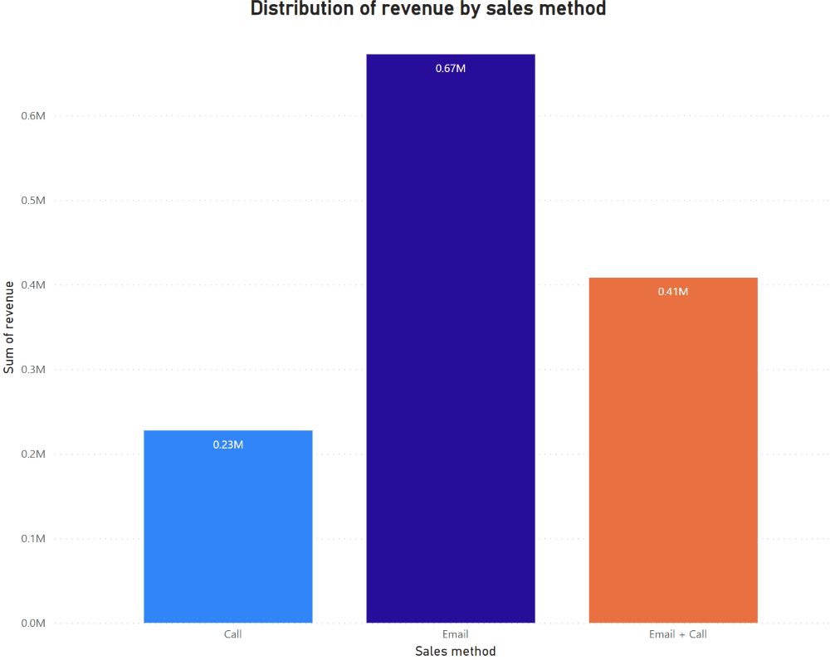
Outcomes What does the spread of the revenue look like for each method?(A)
The revenue which triggered by Email method(0.67 million) took the lead among the three sales method within 6 weeks.
Email + Call method that generated 0.41 million revenue was only 2/3 of revenue by Email method.
Call method was shown the third place(0.23 million) of three sales method which was only 1/3 of revenue of Email approach.
Therefore, the Email method might be considered as most profitable method.

Slide 7
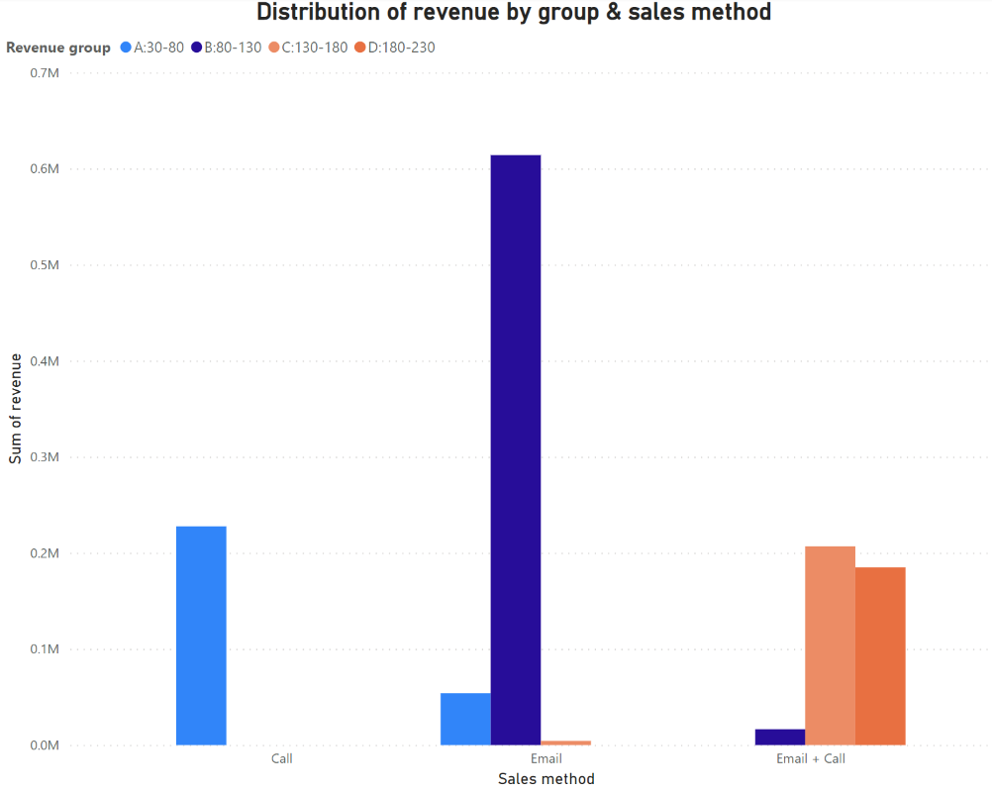
Outcomes What does the spread of the revenue look like for each method?(B)
The vast majority of medium orders (B group) were via Email method.
the Email + Call method took the other two high revenue groups (C and D group).
the Call method produced the majortity of low revenue orders (A group).

Slide 8
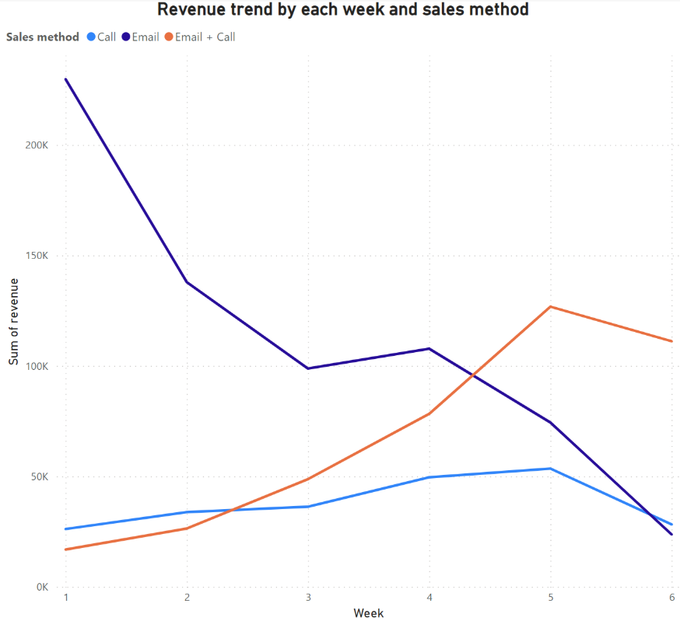
Outcomes Was there any difference in revenue over time for each of the methods?
the revenue of Email method reach the top point at the first week and decreased gradually. -high efficiency
the revenue which produced by Email + Call method slowly increased from week 1 to week 5 and then declined slightly at last week.-low efficiency
the revenue of Call method remain almost stable within 6 weeks. -stay low revenue level

Slide 9
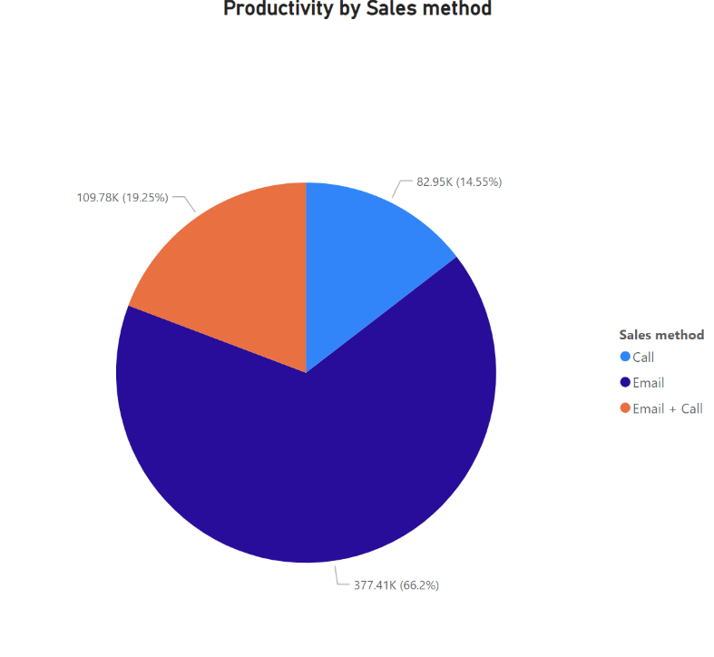
Business Metrics
We need to consider two elements-profitablity and efficiency
Therefore, we build up the "productivity by each sales methods" metrics that can help us to select which sales method was recommended. The caculation of this metrcis is total revenue of each sales method divided by week.
the Email method took 67% of total productivity which was recommened sales method.
So if one of the productivity of sales method higher than other methods in the following weeks, then this method should be chosen.

Slide 10
Recommendations
Using key metrics to monitor productivity of each sales method to decide which method would be majorly continue to use.
Consider to drop the Call method due to the lowest productivity and also take much more time to process.
Integrate the Email and Email + Call sales method:
- Email all the customers by using Email method.
- After two emails, focus those customers who have further reply by making a short call to give more details about products (new Email + Call method).
Data collection for in-depth analysis
- Improve data quality - filling the other 1000+ missing revenue value
- Require new related data - collecting more financial detail, filtering and classifing high value customers and implementing one-to-one customer service & relative reward plan for them

